Slide 1
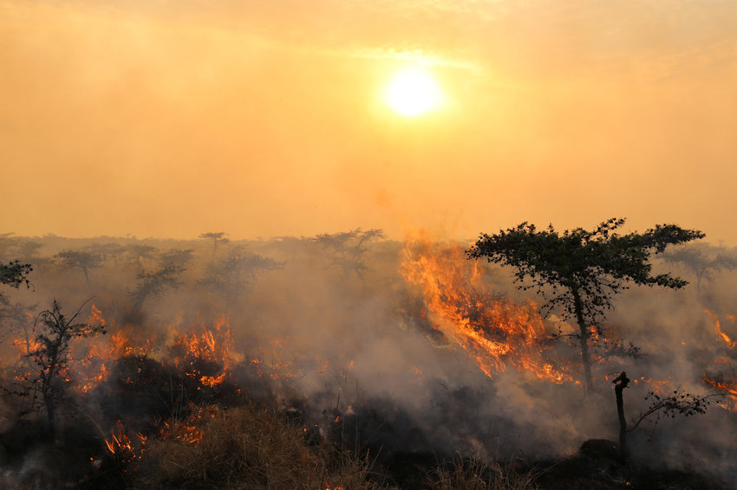
Vegetation Patterns and their susceptibility to wildfires
Bradley van Hooff, Mats Heine, Barber Vos, Leonardo Lüder
Notes:
This presentation will be about our project. Which is about vegetation patterns.

Slide 2
Agenda
Introduction
Models
Grass-Tree Model
Klausmeier Model
Result patterns
Analysis
Results fire implementation
Discussion
Conclusion

Slide 3
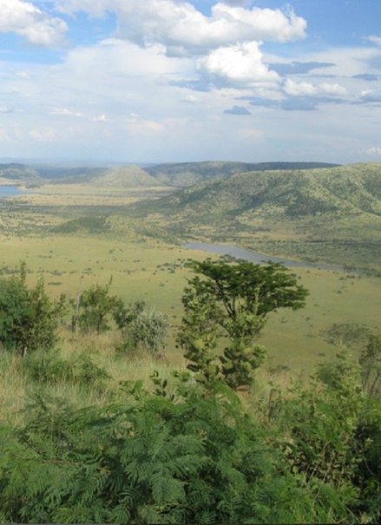
Introduction
The vegetation inlcudes mainly
Trees
Higher Biomass, slower spreading, less susceptible to fire
Grass
Faster spreading, very susceptible to fire
Water
Formation of patterns

Slide 4
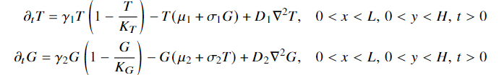
Grass-Tree Model
Growth
Mortality
Spreading
γ: Growth rates
K: upper bound for Biomass
μ: general mortality rate
σ: mortality trough competition
D: Diffusion coefficients

Slide 5
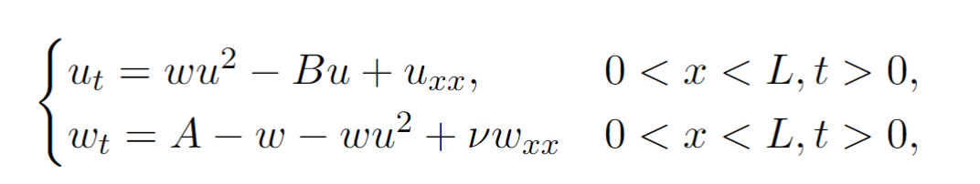
Klausmeier Model
Growth
Mortality
Spreading
Evaporation
Spreading
Precipitation
Consumption water by vegetation

Slide 6
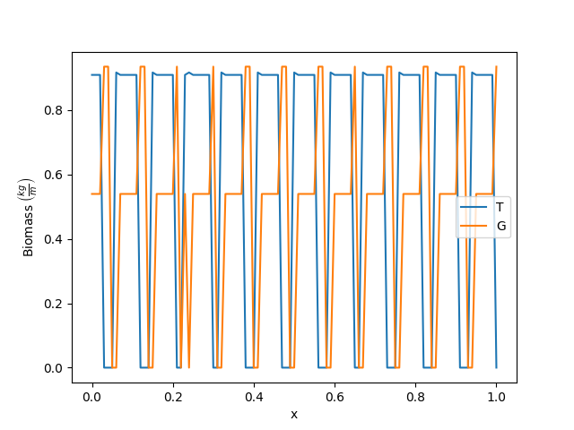
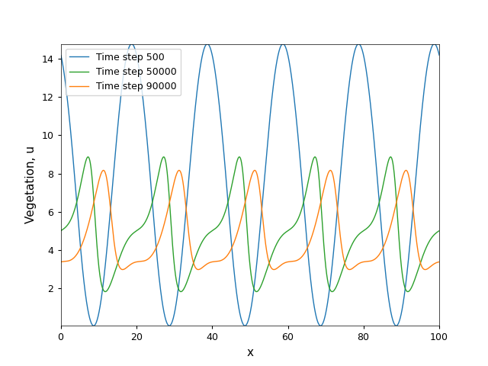
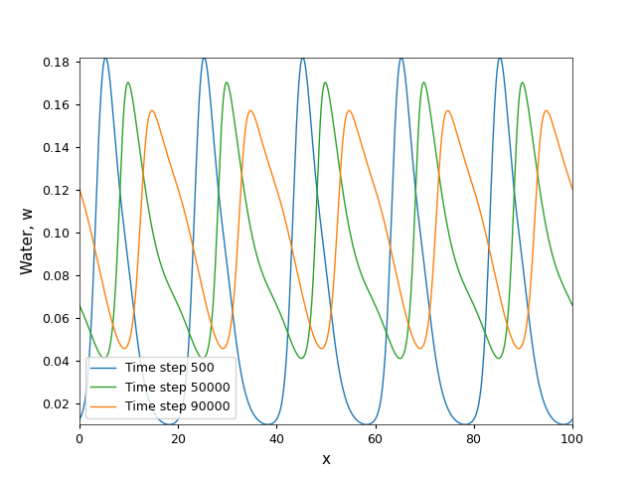
Patterns
Grass Tree Model (Pattern unstable)
Klausmeier Model (Pattern in vegetation and water stable)
Numerical schemes used:
Central differences
rk4

Slide 7
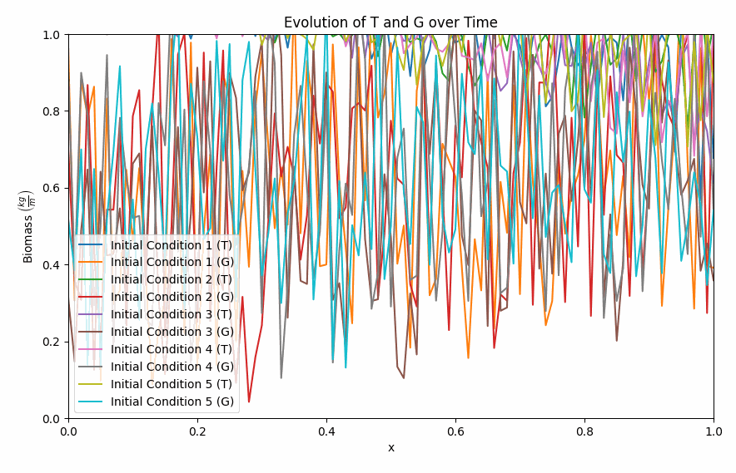
Patterns
Grass Tree Model (Pattern unstable)
Klausmeier Model (Pattern in vegetation and water stable)

Slide 8
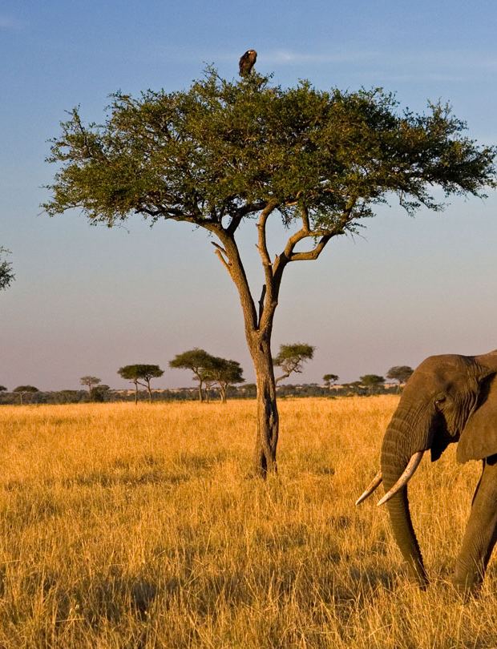
Why are there no stable patterns in the Tree-Grass Model?
https://www.snexplores.org/wp-content/uploads/2021/12/1440_SS_savanna_feat.jpg

Slide 9
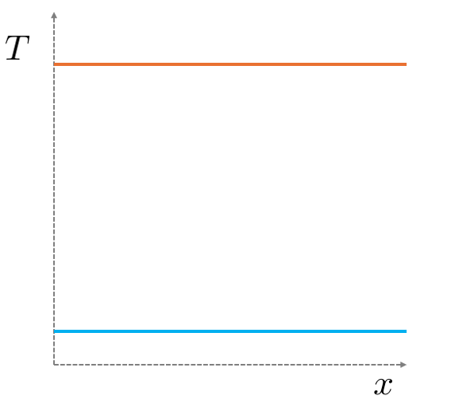
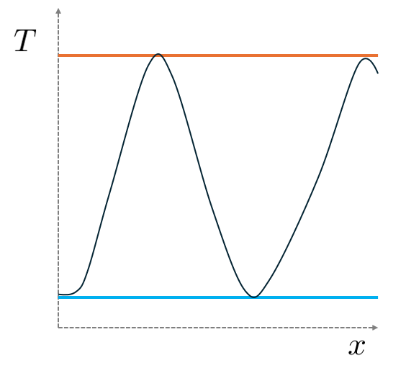
Stable patterns only occur in between spatially homogeneous equilibrium solutions

Slide 10
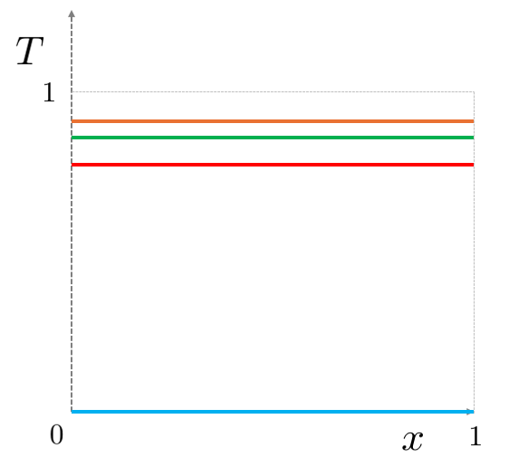
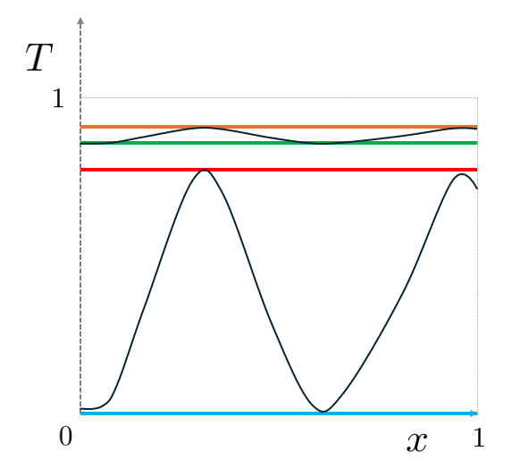
We have 4 relevant homogeneous equilibria
?

Slide 11
We need stability for most “random” perturbations

Slide 12
We need stability for most “random” perturbations

Slide 13
And instability for perturbations with a certain period

Slide 14
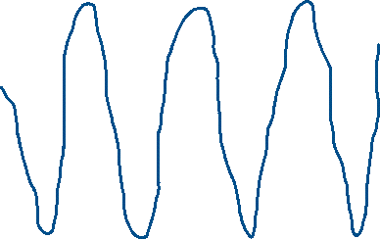
After time-integration, a stable pattern emerges

Slide 15
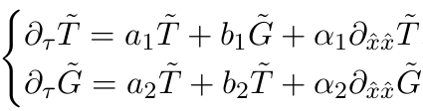
How to determine these periods?
A small perturbation satisfies a linearized system
Depend on equilibrium
(With homogeneous Dirichlet boundary conditions)

Slide 16
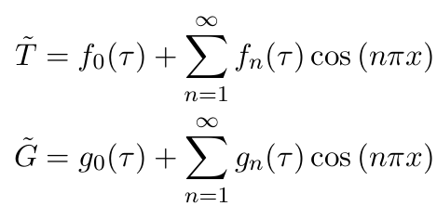
Use eigenfunction expansion
These terms determine the stability

Slide 17
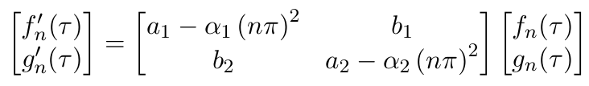
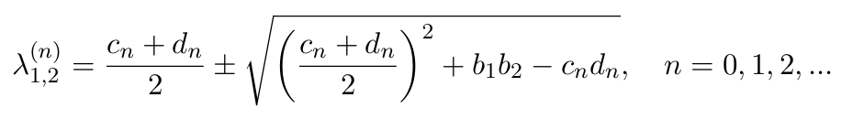
Substitute into the linearised system
Eigenvalues:

Slide 18
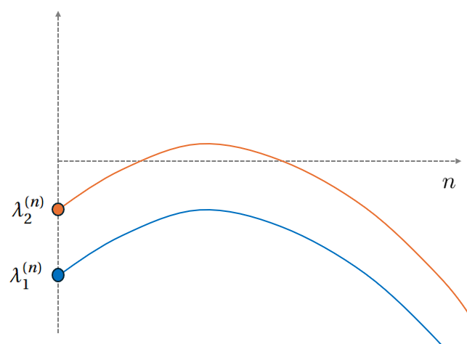
What do we need from these eigenvalues to have stable patterns?

Slide 19
The eigenvalues for n=0 must be negative

Slide 20
There must be a positive eigenvalue

Slide 21
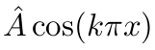
Perturb the homogeneous equilibrium with this period

Slide 22
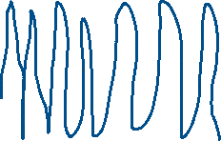
This leads to a stable pattern

Slide 23
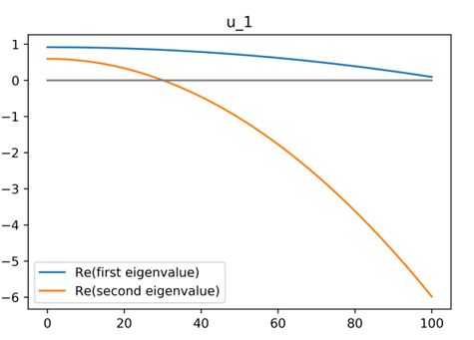
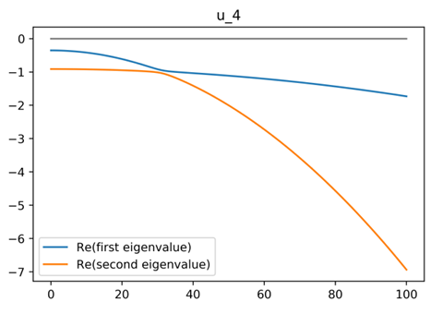
Why do we not have stable patterns?
Patterns
No Patterns

Slide 24
The Klausmeier model does have stable patterns!
(Totally different analysis)
https://www.snexplores.org/wp-content/uploads/2021/12/1440_SS_savanna_feat.jpg

Slide 25
Fire
Burns the vegetation
“Pulse-like” phenomena
Approach:
Let the vegetation reach an equilibrium point
Set the vegetation in an area to 0.2 of its value
Induce a new fire
https://www.researchgate.net/publication/309019756/figure/fig6/AS:416409109712898@1476291076190/Photo5-Example-of-a-fire-in-an-African-savanna-Although-fixers-are-thought-to-have-a.png

Slide 26
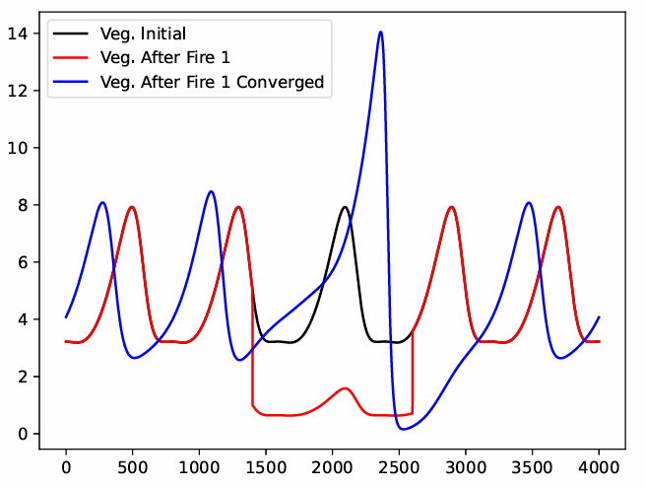
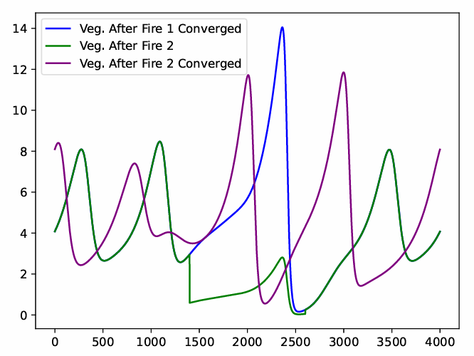
Impact of fire – vegetation

Slide 27
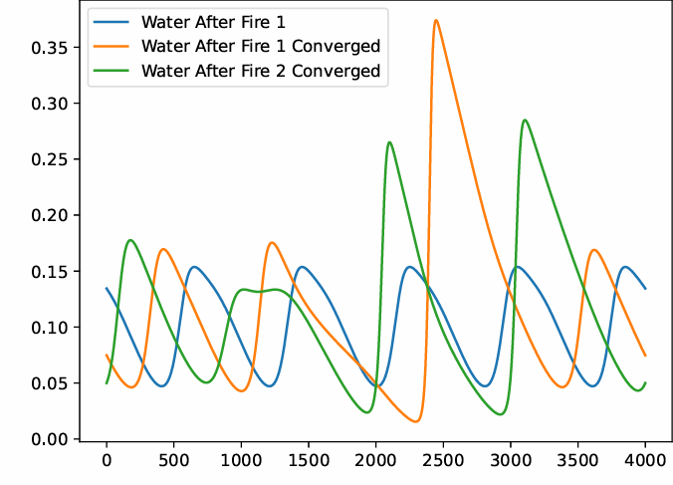
After the fire – new initial condition

Slide 28
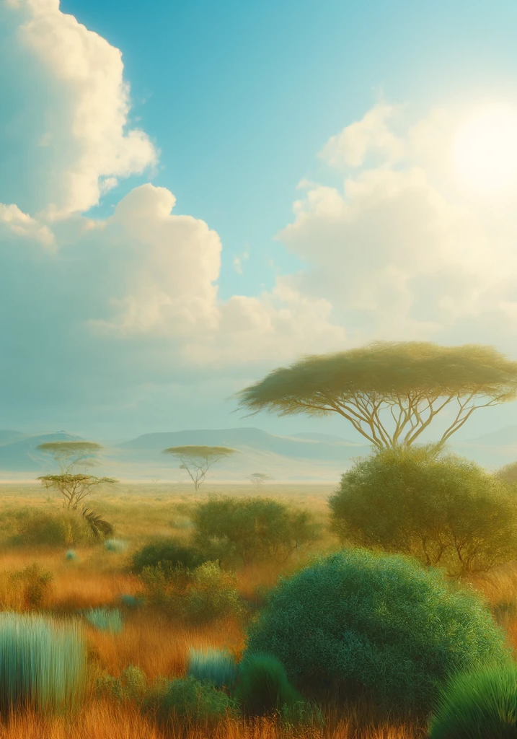
Discussion
Grass-Tree model: no stable patterns
KM model: patterns
Implementation of fire: location based
Results of fire: peak in water and vegatation increased

Slide 29
Conclusion
Models
Analytics
Fire Implementation
Fire leads to a disruption in the pattern: showing higher peaks

Slide 30
Thank you

